Slide 1

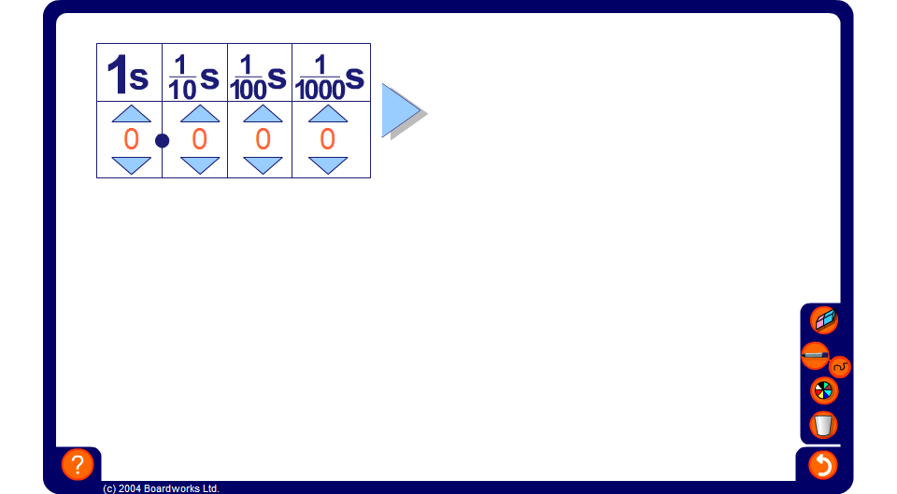


Converting decimals to fractions
Notes:
Start by stating that calculators always show answers as decimals.
It is often helpful to be able to write a given decimal as a fraction. To do this we need to re-visit the place value system.
Remember the first digit after the decimal point tells us the number of tenths, the next digit tells us the number of hundredths, the next digit tells us the number of thousandths.
Let’s start by entering the number 0.35 into the place value chart.
As you enter the digits into the chart say,
There are 0 units, 3 tenths and 5 hundredths.
To add together ³/₁₀s and ⁵/₁₀₀s we need to write ³/₁₀ as ³⁰/₁₀₀. This is equivalent to ³/₁₀ because we multiplied both the numerator and the denominator by the same number, 10.
Click to reveal the next stage in the calculation.
³⁰/₁₀₀ + ⁵/₁₀₀ is equal to ³⁵/₁₀₀.
Why can’t we leave the answer as ³⁵/₁₀₀? We need to cancel this fraction down to its lowest terms. 35 and 100 are both divisible by 5.
Click to reveal the final stage.
0.35 = ⁷/₂₀.
Go through more examples. Take suggestions from pupils.
Suggest to pupils that they could leave some of these stages out. If the decimal has two digits after the decimal point they can just write this number out of 100 and then cancel if necessary.

